Slide 1


K.RAMAKRISHNAN COLLEGE OF TECHNOLOGY
(AUTONOMOUS), TRICHY.
DEPARTMENT OF
COMPUTER SCIENCE AND ENGINEERING
20CS5501 DESIGN PROJECT-1
Batch No. : 07
Date : 05.12.2024

Slide 2
Random Forest Algorithm for Personalized Disease Prediction: A Machine Learning Approach
Guided by Team
Mr. D.P Devan, M.E., Amritha V (811722104009)
Assistant Professor, CSE Boomika T (811722104022)
Harinee M (811722104049)

Slide 3
OBJECTIVE OF THE PROJECT
To collect and preprocess a comprehensive dataset of relevant health information.
To implement and fine-tune the Random Forest algorithm to optimize model performance.
To develop a user-friendly interface for individuals to input their health data and receive personalized risk assessments.
To conduct a thorough analysis of the model's predictions and identify potential areas for improvement.

Slide 4
ABSTRACT
The aim of the study is to develop a personalized disease prediction system using the Random Forest algorithm based on user-supplied symptoms.
The model is trained on a synthetic dataset that includes features such as age, blood pressure, and cholesterol levels, which are commonly associated with various diseases.
The dataset covers multiple diseases, including hypertension, diabetes, heart disease, cancer, kidney disease, lung disease, arthritis, stroke, obesity, and asthma.

Slide 5
LITERATURE SURVEY
TITLE OF THE PAPER | AUTHOR (S) | PUBLISHER | PAPER GIST | TECHNOLOGY USED
Personalized Disease Prediction Using Random Forest: A Data-Driven Machine Learning Approach | Dr.Emily Watson | Journal of Biomedical Informatics | This paper develops a personalized disease prediction model using Random Forest | Programming Tools: Python, pandas, scikit-learn
Random Forest for Early Detection of Infectious Diseases: Personalized Approach | Dr.Arjun Patel | BMC Medical Informatics and Decision Making | This research focuses on early infectious disease detection using patient-specific data | Programming Tools: Python (sklearn, xgboost), MATLAB.
Integrating Genomic and Clinical Data for Personalized Disease Prediction with Random Forests | Dr. Kevin Huang | Computational Biology and Medicine | The paper discusses the integration of genomic and clinical data for personalized disease prediction. | Programming Tools: R, Python, tidyverse, and caret.

Slide 6
LITERATURE SURVEY
TITLE OF THE PAPER | AUTHOR (S) | PUBLISHER | PAPER GIST | TECHNOLOGY USED
Applying Random Forest for Accurate Disease Prediction in Personalized Medicine | V. Jackins, S.Vimal | Institute of Electrical and Electronics Engineers. | It emphasizes how machine learning, Random Forest,provide accurate predictions for multiple diseases. | Programming tools: Python ,Scikit-learn,Pandas,NumPy
Predicting Diseases in Personalized Healthcare: A Random Forest Approach | Mohamed Elhoseny | This journal focuses on the application of information science and technology to healthcare problems. | Discusses the importance of different features in the prediction process. | Programming tools: Ggplot2, Matplotlib, Seaborn
Using Random Forest to Predict Disease Outcomes in Personalized Healthcare Systems | Olga Zolotareva | This journal covers topics in medical informatics, machine learning and decision support systems. | Early diagnosis and personalized treatment plans. | Programming tools: SciPy, Matplotlib, Seaborn
6

Slide 7
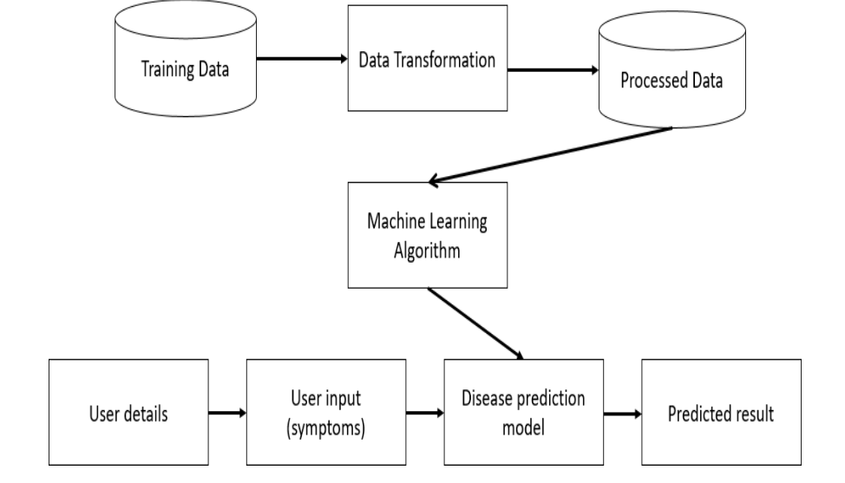
PROPOSED SYSTEM ARCHITECTURE

Slide 8
SOFTWARE AND HARDWARE REQUIREMENTS
HARDWARE
SOFTWARE
Intel Core i5
RAM - 16 GB
Monitor-Responsive to all screens
Windows 10 or Higher
Python
python IDLE

Slide 9
MODULES
Dataset Creation and Saving to CSV
Disease Prediction Model
Model Evaluation and Testing

Slide 10
SUMMARY OF MODULE-1
Synthetic dataset: This module generates a synthetic dataset for disease prediction, including variables such as age, blood pressure, cholesterol levels, and disease presence (randomly assigned).
Outlier Detection and Treatment: Identify and handle outliers that can skew the model's performance.
Identify Sources: Gather data from various sources like EHRs, clinical trials, public health databases, wearable devices, and patient surveys.
Create New Features: Derive new features from existing ones to capture more relevant information.

Slide 11
SUMMARY OF MODULE-2
Random Forest Implementation: Implementing the Random Forest algorithm, a powerful ensemble learning technique.
Hyperparameter Tuning: Optimizing the model's performance by adjusting hyperparameters like the number of trees and maximum depth.
Model Training: Training the model on the prepared training dataset to learn patterns and relationships between features and the target variable.
Personalized Model Development: Incorporating patient-specific information to create personalized prediction models for each individual.

Slide 12
SUMMARY OF MODULE-3
Performance Metrics: Evaluating the model's performance using metrics like accuracy, precision, recall, F1-score, and AUC-ROC.
Confusion Matrix: Analyzing the model's predictions in detail to identify areas of strength and weakness.
Cross-Validation: Assessing the model's generalization performance using techniques like k-fold cross-validation.
Model Validation: Testing the model on the testing dataset to evaluate its performance on unseen data.

Slide 13
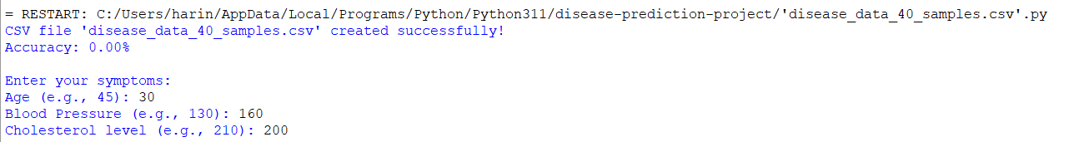
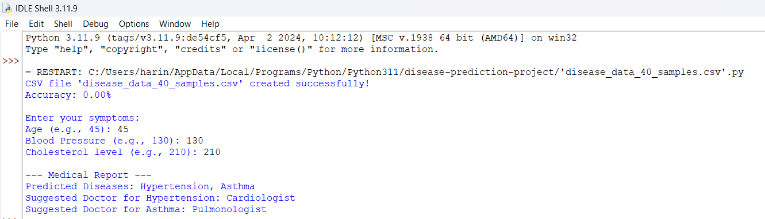
RESULTS AND DISCUSSION

Slide 14
CONCLUSION
In this project, we developed a personalized disease prediction model using the Random Forest algorithm, a robust and versatile machine learning approach.
The study demonstrated the effectiveness of Random Forest in analyzing complex symptom-disease relationships and delivering accurate predictions.
This personalized approach to disease prediction has significant potential in early diagnosis, improving patient outcomes, and reducing the burden on healthcare systems.
Future work could focus on expanding the dataset, integrating additional features such as genetic information or lifestyle factors, and deploying the model into user-friendly applications for widespread accessibility.

Slide 15
THANK YOU

